Slide 1
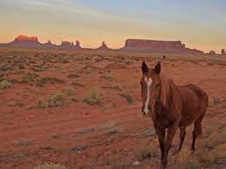
A Tool With No Name
Robert Reitmeier
Notes:
+

Slide 2
Contents
Recap: The Challenge
State of the Art Assessment

Slide 3
Bulletpoints
The Efficieny of Lazyness (search space reduction)
Branch, MC/DC, or Path Coverage (Statement follows from Branch)
Only Toplevel function coverage or full depth
Interface: Input C-Source (maybe already preprocessed), Output customizable (currently solutions.txt with ForeC )
Cutoffs (from Chess Programming)
Hourglass optimization?
Theoretical Work: Show Confluence of Trace Transformations, Normalization
Result Verification by Execution
Manual Search Optimization (solver_*functions)
Model level debugging (solver_debug)
Properties of the Prototype
3000 LoC, all in one file (refactoring!), extensive logging
Loop Length Inference
Pointer Casting requires going down to memory bit level
New(?) Method for MC/DC table generation
Surprising Facts (Loop breaking e.g.)
Test Suite: Show Test for Break
Compilation of Source Code Snippets
State Of the Art?
Surprises (like loop break example)
Performance in Project qkitknorrbremse
One Test Run
Potential (other than Coverage Completion)
Automatic Compiler Qualification Test Suite Creation
Rendering CTC superfluous (“How to make enemies”?)
Outstripping VectorCAST (“How to make enemies”?)
Discover Semantic Error Patterns (Dead code e.g.)
C++ Parser needed -> all for C++

Slide 4
The Challenge
Library Qualification: ISO26262 demands 100% MC/DC Source Code Coverage for ASIL D !
Given: C Source Code of a Library function
Needed: All function arguments (=“test vectors”) so that we reach 100 % MC/DC coverage when running our tests

Slide 5
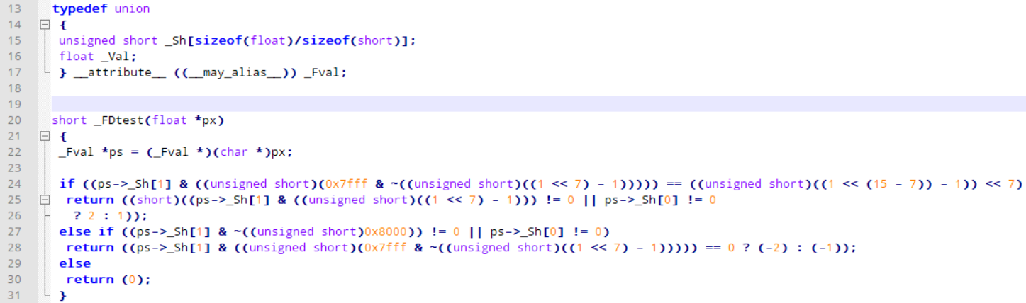
Challenge Example _FDtest
---- Trace [1,1] -----------------------------------
_FDtest ( px = <SOME_PTR> , PTR_px = NaN(0x00ffff) = 0xff80ffff = NaN ) = return_val = 2
Covered branches:
Then branch 1 "if((ps->_Sh[1] & (unsigned short) (0x7fff & ..." at line 24, col 7, len 124
Then branch 1 "(F||T)" at line 25, col 20, len 70

Slide 6
Challenge 4 U
How many test vectors needed for 100% MC/DC coverage?
if (line 24)
then
else
3
else if (line 27)
T || _
F || F
2
F || T
1
1
2

Slide 7
Challenge Solution _FDtest
---- Trace [1,1] -----------------------------------
_FDtest ( px = <SOME_PTR> , PTR_px = NaN(0x00ffff) = 0xff80ffff = NaN ) = return_val = 2
Covered branches:
Then branch 1 "if((ps->_Sh[1] & (unsigned short) (0x7fff & ..." at line 24, col 7, len 124
Then branch 1 "(F||T)" at line 25, col 20, len 70
---- Trace [1,2] -----------------------------------
_FDtest ( px = <SOME_PTR> , PTR_px = -Infinity = 0xff800000 = -Infinity ) = return_val = 1
Covered branches:
Then branch 1 "if((ps->_Sh[1] & (unsigned short) (0x7fff & ..." at line 24, col 7, len 124
Else branch 2 "(F||F)" at line 25, col 20, len 70
---- Trace [1,3] -----------------------------------
_FDtest ( px = <SOME_PTR> , PTR_px = NaN(0x7f0000) = 0xffff0000 = NaN ) = return_val = 2
Covered branches:
Then branch 1 "if((ps->_Sh[1] & (unsigned short) (0x7fff & ..." at line 24, col 7, len 124
Then branch 3 "(T||F)" at line 25, col 20, len 70
---- Trace [2,1,1] -----------------------------------
_FDtest ( px = <SOME_PTR> , PTR_px = 0x1p-149 = 0x00000001 = 1.0e-45 ) = return_val = -2
Covered branches:
Else branch 2 "if((ps->_Sh[1] & (unsigned short) (0x7fff & ..." at line 24, col 7, len 124
Then branch 1 "(F||T)" at line 27, col 12, len 63
Then branch 1 "(ps->_Sh[1] & (unsigned short) (0x7fff & ..." at line 28, col 12, len 81
---- Trace [2,2] -----------------------------------
_FDtest ( px = <SOME_PTR> , PTR_px = 0x0p+0 = 0x00000000 = 0.0 ) = return_val = 0
Covered branches:
Else branch 2 "if((ps->_Sh[1] & (unsigned short) (0x7fff & ..." at line 24, col 7, len 124
Else branch 2 "(F||F)" at line 27, col 12, len 63
---- Trace [2,3,1] -----------------------------------
_FDtest ( px = <SOME_PTR> , PTR_px = -0x1.fcp-127 = 0x807f0000 = -1.1663108e-38 ) = return_val = -2
Covered branches:
Else branch 2 "if((ps->_Sh[1] & (unsigned short) (0x7fff & ..." at line 24, col 7, len 124
Then branch 3 "(T||F)" at line 27, col 12, len 63
Then branch 1 "(ps->_Sh[1] & (unsigned short) (0x7fff & ..." at line 28, col 12, len 81
---- Trace [2,3,2] -----------------------------------
_FDtest ( px = <SOME_PTR> , PTR_px = -0x1.fep127 = 0xff7f0000 = -3.3895314e38 ) = return_val = -1
Covered branches:
Else branch 2 "if((ps->_Sh[1] & (unsigned short) (0x7fff & ..." at line 24, col 7, len 124
Then branch 3 "(T||F)" at line 27, col 12, len 63
Else branch 2 "(ps->_Sh[1] & (unsigned short) (0x7fff & ..." at line 28, col 12, len 81

Slide 8
How Did It Do That?
For all possible paths through the code:
Garble up all decision conditions on each path (if, switch, conditional expressions, loop conditions)
Assume them true of false (depending on the branch to take)
Translate the assumptions to theorem prover language
Have the theorem prover solve the formula
Remember solution models (if any)
f(x,y)
True
if A then
(A(x,y))
else
(¬A)
if B||C then
(B)
if B||C then
(¬B ∧ C)
else
(¬B ∧ ¬C)
return 1;
A ∧ B
return 2;
A ∧ (¬B ∧ C)
return 3;
¬A ∧ (¬B ∧ ¬C)
return 4;
¬A

Slide 9
Efficiency of Laziness
Lazy := Unneeded code is not evaluated
Cutoff Trace not evaluated
A || B
B || C
(A(x,y))
else
(¬A)
B
¬B ∧ C
¬B ∧ ¬C
return 1;
A ∧ B
return 2;
A ∧ (¬B ∧ C)
return 3;
¬A ∧ (¬B ∧ ¬C)
return 4;
¬A

Slide 10
Definiton of “Trace”
Trace [1,3]
f(x,y)
True
1
2
if A then
(A(x,y))
else
(¬A)
1
2
3
if B||C then
(B)
if B||C then
(¬B ∧ C)
else
(¬B ∧ ¬C)
return 1;
A ∧ B
return 2;
A ∧ (¬B ∧ C)
return 3;
¬A ∧ (¬B ∧ ¬C)
return 4;
¬A

Slide 11
Z3 Formula for _FDtest [1,1]
if((ps->_Sh[1] & (unsigned short) (0x7fff & ~(unsigned short) ((1 << 7) - 1))) == (unsigned short) ((1 << 15 - 7) - 1) << 7)
; ----------------------------------------------
; COND Then branch 1 "if((ps->_Sh[1] & …
; ----------------------------------------------
(assert
(=
((_ zero_extend 16)
(bvand
(select
arr$$5
#x00000001
)
((_ extract 15 0)
(bvand
#x00007fff
((_ zero_extend 16)
(bvnot
((_ extract 15 0)
(bvsub
(bvshl
#x00000001
#x00000007
)
#x00000001
)
)
)
)
)
)
(bvshl
((_ zero_extend 16)
((_ extract 15 0)
(bvsub
(bvshl
#x00000001
(bvsub
#x0000000f
#x00000007
)
)
#x00000001
)
)
)
#x00000007
)

Slide 12
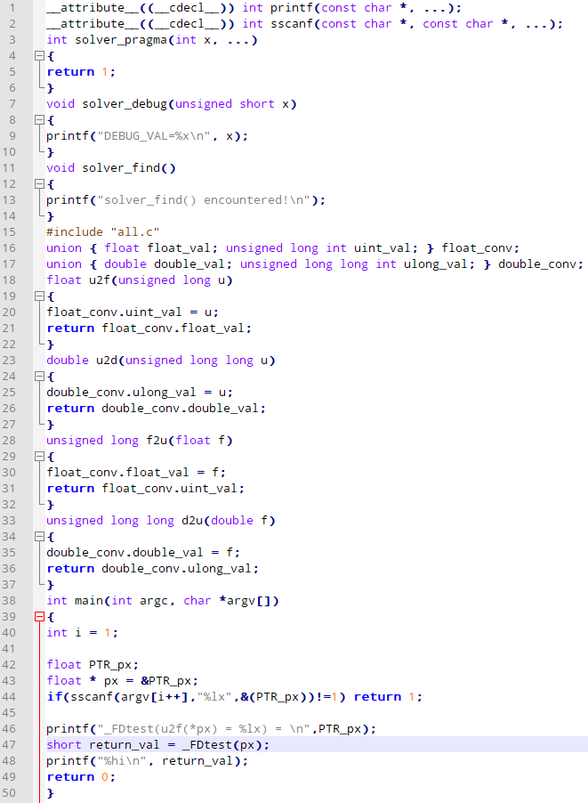
Trace Result Verification
short _FDtest(float *px)
Compile and execute the code: Result = Prediction?
Get arguments from commandline
Execute function Print return value to stdout

Slide 13
Template
Library Qualification: ISO26262 demands

Slide 14
Solver Pragma
solver_pragma(…) :
→ Only follow one path at a time
1
2
if (solver_pragma(2,3) && A) then
…
1
3
1st
2
2nd
…
…
…

Slide 15
Solver Debug
solver_debug(<expr>) :
→ “Model Level Debugging”: Print theoretical value of <expr> at this point
int g(int x,int y) { int erg = x; while(y>0) { solver_debug(y); erg = erg << 1; y=y-1; } if(erg<=1) { erg=100; } return(erg); }

Slide 16
Solver Loop Pragma
solver_pragma ( i1 , i2 , … ) in loop condition: → Only unroll loop i1 , i2 , … times
for(int i=0;solver_pragma(0,1,2) && i<(n%3);i++)
{
if(arr[i]>0) arr[i] *= 2;
j += arr[i];
}

Slide 17
Solver Find
short _FDint(float *px, short xexp)
{
_Fval *ps = (_Fval *)(char *)px;
unsigned short frac;
short xchar = (ps->_Sh[1] & ((unsigned short)(0x7fff & ~((unsigned short)((1 << 7) - 1))))) >> 7;
if (xchar == ((unsigned short)((1 << (15 - 7)) - 1)))
return ((ps->_Sh[1] & ((unsigned short)((1 << 7) - 1))) == 0 && ps->_Sh[0] == 0
? 1 : 2);
else if ((ps->_Sh[1] & ~((unsigned short)0x8000)) == 0 && ps->_Sh[0] == 0)
return (0);
xchar = (0x7e + 16 + 7 + 1) - xchar - xexp;
if (xchar <= 0)
return (0);
else if ((16 + 7 + 1) <= xchar)
{
ps->_Sh[1] &= ((unsigned short)0x8000);
ps->_Sh[0] = 0;
solver_find();
return ((-1));
}
else
{
static const unsigned short mask[] = {
0x0000, 0x0001, 0x0003, 0x0007,
0x000f, 0x001f, 0x003f, 0x007f,
0x00ff, 0x01ff, 0x03ff, 0x07ff,
0x0fff, 0x1fff, 0x3fff, 0x7fff};
static const size_t sub[] = {0, 1};
frac = mask[xchar & 0xf];
xchar >>= 4;
frac &= ps->_Sh[sub[xchar]];
ps->_Sh[sub[xchar]] ^= frac;
if (0 < xchar)
frac |= ps->_Sh[0], ps->_Sh[0] = 0;
return (frac != 0 ? (-1) : 0);
}
}
Only consider traces with solver_find ()

Slide 18
QkitKnorrBremse Performance
ASIL D Library Qualification (Dinkumware and libgcc)
Filling coverage gaps from ForeSEE tests
Found all solutions for
ceilf
__udiv6432
fabsf
roundf
Delivered MC/DC coverage proof for ternary if’s in
_FDtest
fminf
sqrtf: 3 of 11 traces could not be solved by Z3, because
Formulas to the power of eight(!)
Search space is vast… 20h on compute server.

Slide 19
MC/DC Table Generation
New ?!
Works inductively. Given MC/DC Tables for A and B: How to combine them to get a table for A || B ?
Example: A || (B1 && B2 )
A | A
F | F
T | T
||
B1 | B2 | B1 && B2
F | _ | F
T | F | F
T | T | T
concat
Sidenote:
Dual for A && B
For A ∧∨ B : a bit more complex (works symmetrical)
A | B1 | B2 | A || (B1 && B2)
F | F | _ | F
F | T | F | F
F | T | T | T
T | _ | _ | T
Don‘t care

Slide 20
MC/DC Table Implementation
createMCDCTables :: CExpr → [ MCDC_Branch ]
createMCDCTables expr = case expr of
CBinary binop expr1 expr2 _ | binop ∈ [ CLorOp, CLndOp ] →
[ MCDC_Branch ("("++name1++ (render.pretty) binop ++ to_dontcare name2 ++")") shortcut cond1 |
MCDC_Branch name1 result1 cond1 <- t1,
result1 == shortcut,
MCDC_Branch name2 _ _ <- take 1 t2 ]
++
[ MCDC_Branch ("("++name1++ (render.pretty) binop ++name2++")") result2 (cond1 ⋏ cond2) |
MCDC_Branch name1 result1 cond1 <- t1,
result1 == not shortcut,
MCDC_Branch name2 result2 cond2 <- t2 ]
where
shortcut = case binop of
CLorOp -> True
CLndOp -> False
(t1,t2) = ( createMCDCTables expr1 , createMCDCTables expr2 )
to_dontcare s = for s $ \case
'F' -> '_'
'T' -> '_'
other -> other
expr → [ MCDC_Branch "T" True expr,
MCDC_Branch "F" False (not_ expr) ]

Slide 21
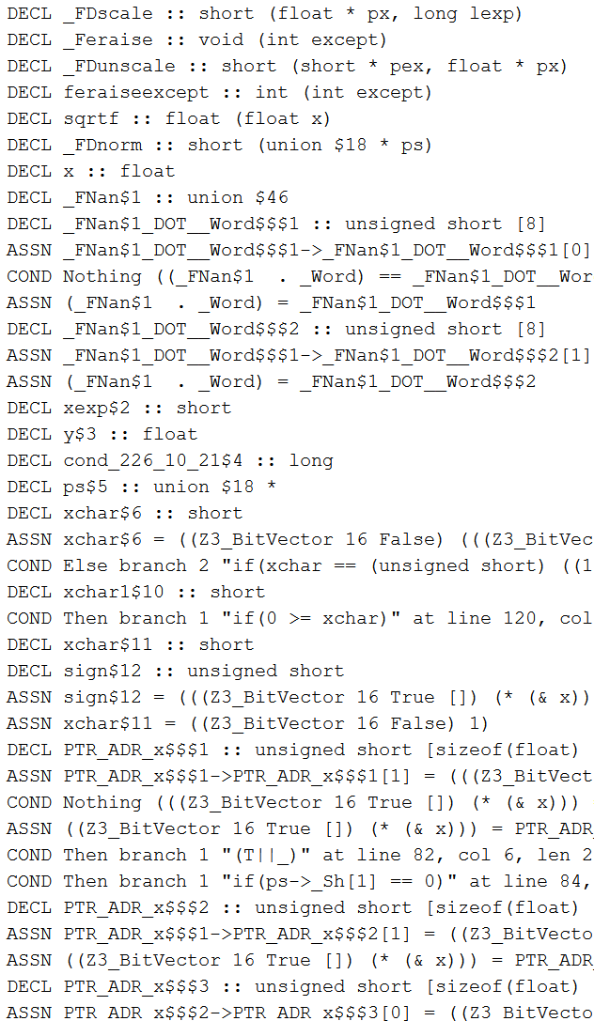





Cutoffs
Inspired by α-/β - Cutoffs from Chess Programming
Formula $φ$ monotonic in models when adding assertion $φ′$:
$$∄ ℳ. ℳ \text{⊧} φ \overset{⇒}{ } ∄ ℳ^{′}.ℳ′ \text{⊧} φ \text{∧} φ^{′}$$
$$φ$$
Towards RETURN
Cutoff if no solution for $φ !$
$$φ′$$
Stats {cutoffTriesS = 28851, cutoffsS = 28635, numTracesS = 29037, numSolutionS = 8, numNoSolutionS = 179}

Slide 22
Strategic Design Principles
Make it as easy as possible for the theorem prover (for example: no ∀, ∃), because:
Z3 not under my control („black box“)
More semantic information available for the tool
Extensive Logging (Dynamic HTML)
Defensive Programming: Throw errors in all cases that were not explicitly implemented

Slide 23

Loop Length Inference
Infer loop length (possible for most loops): same strictly montone counter manipulation in every body trace? E.g.
${(x=x≫1;)}^{n} \underset{⇒}{ } x\left(n\right)=x_{0}≫n$ $${(x++;)}^{n} ={(x=x+1;)}^{n} \underset{⇒}{ } x(n)=x_{0}+n$$
…
n ⩾ _0, not_ cond_0 ⋏ n ⩵ _0 ⋎ cond_nminus1 ⋏ n ⩾ _1 ⋏ not_ cond_n

Slide 24
Loop Length Inference Example
fp-bit.c
See log.html
bit = IMPLICIT_1; // = 1<<30
quotient = 0;
while (bit)
{
if (numerator >= denominator)
{
quotient |= bit;
numerator -= denominator;
}
bit >>= 1;
numerator *= 2;
}
n ⩾ _0, not_ (1<<30 /= 0) ⋏ n ⩵ _0 ⋎ ((1<<30)>>(n-1) /= 0 ) ⋏ n ⩾ _1 ⋏ not_ ((1<<30)>>n /= 0)

Slide 25

Loop Length Inference Efficiency
t traces in a loop body, loops n times, d binary decisions before or after the loop: $2^{d}∙\sum_{n=0}^{n_{loops}}{t^{n}}$ traces to examine.
Incremental search: $2^{3}∙\sum_{n=0}^{30}{2^{n}}=17.179.869.176$
Exactly 30 iterations: $2^{3}∙ 2^{30}=8.589.934.592$
In general: Factor 𝒪(t)
bit = IMPLICIT_1; // = 1<<30
quotient = 0;
while (bit)
{
if (numerator >= denominator)
{
quotient |= bit;
numerator -= denominator;
}
bit >>= 1;
numerator *= 2;
}

Slide 26
Future Work
Refactor for Side Effects in Expressions
Incremental Solving (pushing assertions, goes well with cutoffs!)
Semantic Simplifications?!
Hourglass Optimization
Logical isolation of functions
Better understanding of inner workings of Z3
Extracting Code Snippets automatically
C++ (when C++ Parser is available)

Slide 27


